Slide 1
Power and prediction
Innovation using AI
Seminary 3

Slide 2
AI is Everywhere... Even in Your Pocket
Face ID/Touch ID: How does your phone know it's you?
Spam Filters: How does email know what's junk?
Netflix/TikTok Recommendations: How do these apps know exactly what you'll like next?
Smart Reply/Autocorrect: How does your keyboard predict your next word?
Notes:
hink for a moment: What other 'invisible' AIs do you interact with every single day?

Slide 3
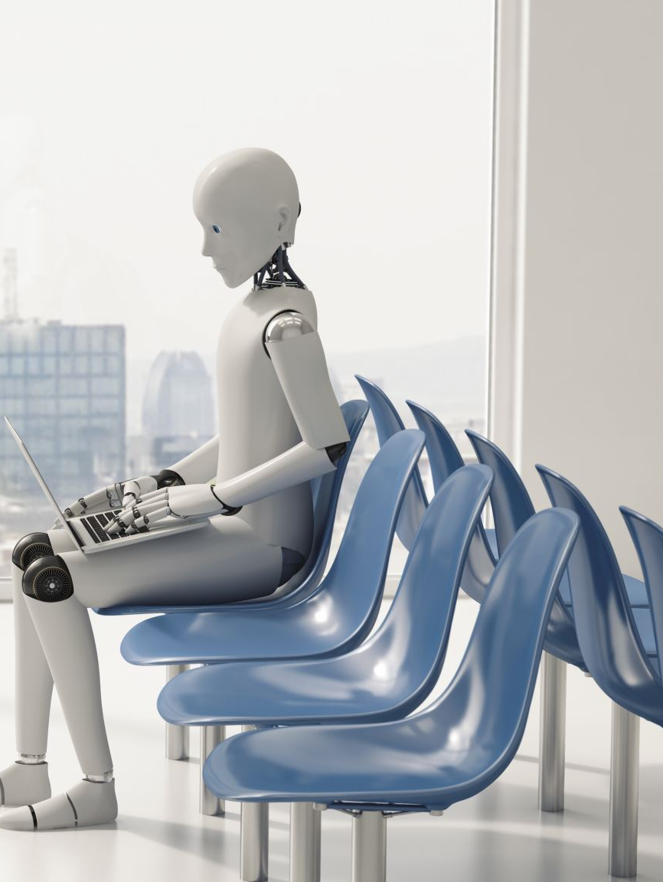
Beyond the Hype: What is AI, Really?
AI is simply about building systems that can perform tasks that typically require human intelligence.
It is mostly learning from past data to make future predictions.

Slide 4

A Machine Learning algorithm walks into a bar
The bartender asks "What will you have?".
The algorithm says "What's everyone else having?"

Slide 5

Challenges
Data quality and availability
Computing power
Integration with existing systems
Deep-learning algorithms are opaque
Security flaws
Lack of expertise
Costs
Ethical and legal considerations
(data privacy and biases)

Slide 6
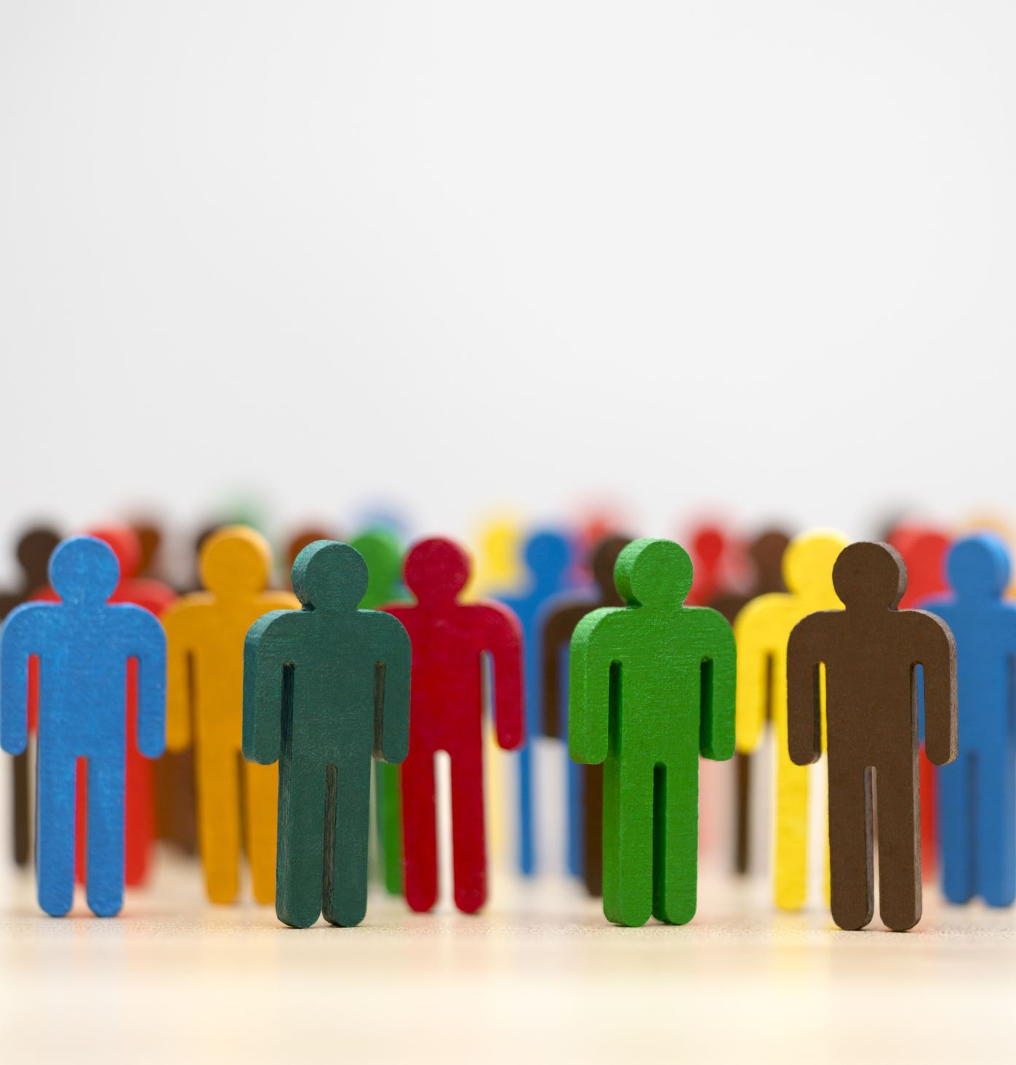
Ethics-Concerns
AI may have embedded bias
Climate degradation
Human rights
Surveillance
Interferences on Democratics elections
Deepfakes
Algorithmic Amplification, Filter Bubbles, Echo Chambers
Inequalities
Women, minority groups, marginalized people.
Bank loans
Hiring process

Slide 7

Train an AI model
Steps:
Requirements
Data collection
Data cleaning
Model training
Validation
Deploy
Integrate in app

Slide 8

Requirements
Input/output
What data do I need (privacy issues)
Metrics
How is the problem solved now?
Is it accurate?
Non-functional requirements?
Power, latency?
Cost?

Slide 9
Data collection
https://www.kaggle.com/datasets
https://huggingface.co/datasets
Possible tasks
ChatTemplate

Slide 10
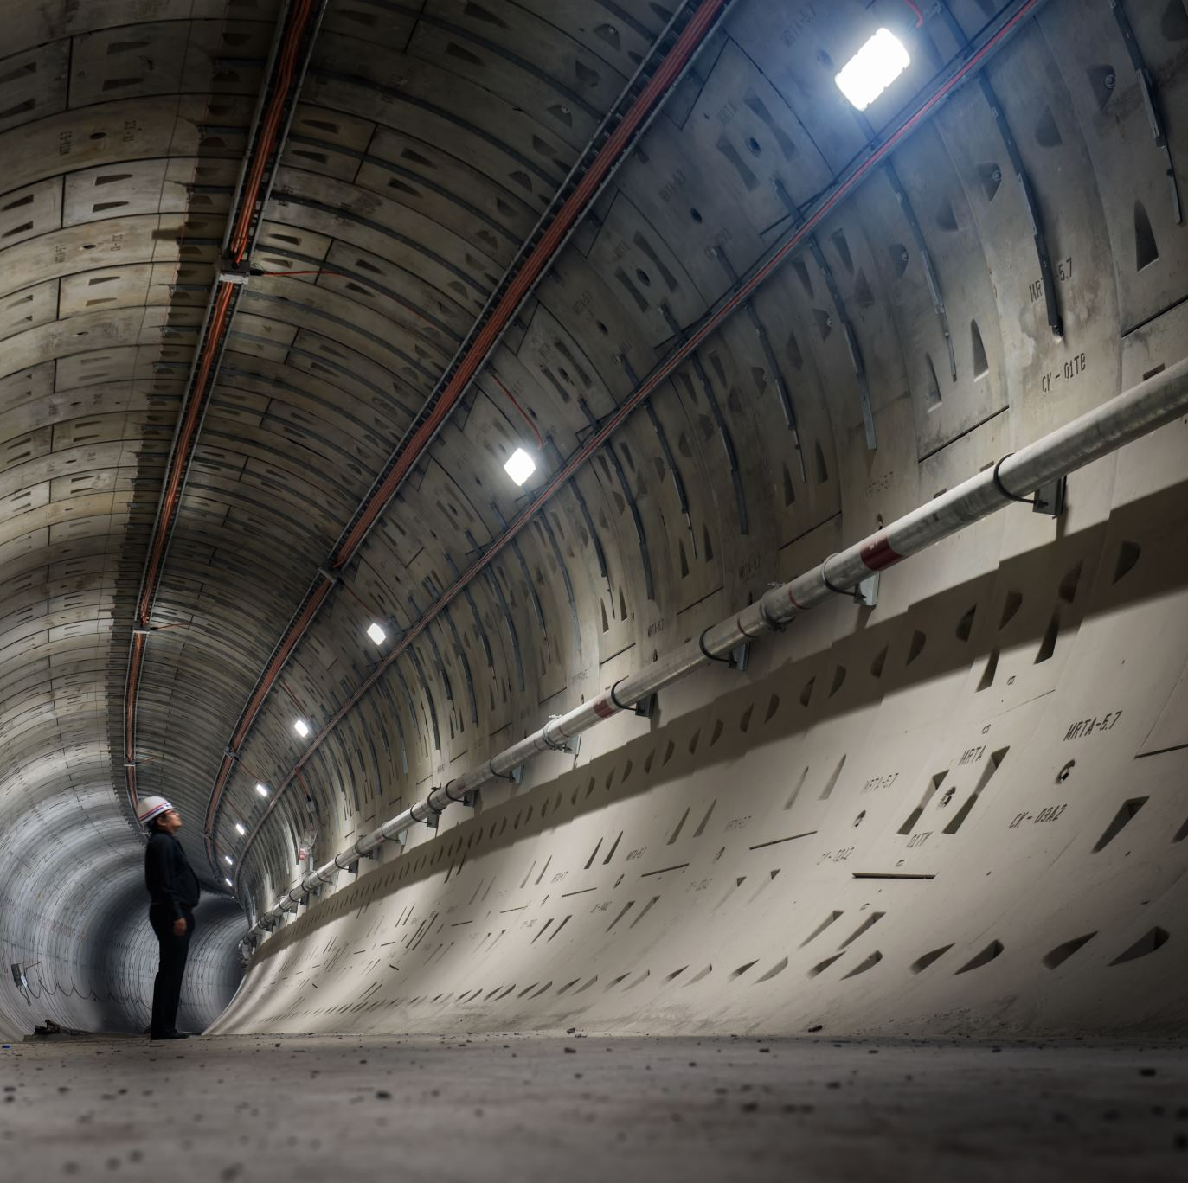
Train Validation Deploy
Training
Validation
Deploy
cloud
local
edge

Slide 11
Milestone 3 (Eng: week 7, Ro: week 8)
Theme: To gather, clean, and understand the data that will power your application's core intelligence.
Tasks:
Intensive Data Collection: Execute a comprehensive data collection process. Gather as much relevant data as possible from public sources, and crucially, consult with your challenge owners to see if they can provide real-world datasets.
Data Cleaning & Formatting: Consolidate all collected data into a single, uniform, and clean format (e.g., a well-structured CSV file, a folder of organized images, or a JSON dataset). Document the structure of your final dataset.
Exploratory Data Analysis (EDA): In a Jupyter/Colab notebook, analyze your cleaned dataset. Generate visualizations (e.g., histograms, scatter plots) and summary statistics to understand its properties, distributions, and potential biases.
Deliverable: A PDF containing the description to your dataset, and some screen shots or a link to the notebook showing your Exploratory Data Analysis and key findings. (uploaded on the MSTeams Assignment 3, by one team member)
Update! IF YOU DON'T PLAN TO FINE TUNE A MODEL, MAKE A DESCRIPTION OF THE DATA WAS USED FOR TRAINING THE MODEL.

Slide 12

References
https://srinstitute.utoronto.ca/news/power-and-prediction-avi-goldfarb-on-the-disruptive-economics-of-ai
https://www.forbes.com/sites/bernardmarr/2023/05/10/15-amazing-real-world-applications-of-ai-everyone-should-know-about/
https://ideausher.com/blog/how-to-build-an-ai-application/
https://www.unesco.org/en/artificial-intelligence/recommendation-ethics
https://www.linkedin.com/pulse/challenges-implementing-ai-case-muller/
https://www.datacamp.com/tutorial/techniques-to-handle-missing-data-values

Slide 13
Chat Template
<|begin_of_text|><|start_header_id|>system<|end_header_id|> You are a simulated dental patient with the following condition: Irreversible Pulpitis. Your task is to respond realistically to a student doctor... Do NOT state your final diagnosis.<|eot|>
<|start_header_id|>user<|end_header_id|> Student: Hello, what brings you in today? <|eot|>
<|start_header_id|>assistant<|end_header_id|> Patient: I have a throbbing, intense pain in my upper right back tooth. It's really sensitive to cold things.<|eot|>
<|start_header_id|>user<|end_header_id|> Student: How long does the pain last after exposure to cold? <|eot|>
<|start_header_id|>assistant<|end_header_id|> Patient: It lingers for several minutes, even after the cold is gone, and sometimes I feel it spontaneously. <|eot|>
Notes:
By doing this, the model learns the following behavior:
Rule 1 (Context): When it sees the system prompt (...condition: Irreversible Pulpitis...), it activates the knowledge required to simulate those symptoms.
Rule 2 (Role-play): When it sees the user prompt (<|start_header_id|>user<|end_header_id|>), it knows its job is to act as the patient and generate the appropriate answer tokens.

Slide 14
Dataset for blind people
VizWiz-VQA (This dataset consists of images taken by blind users and questions they actually asked)
LLaVA-Instruct-150K (It contains diverse image-instruction-answer triplets )
TextCaps, COCO-Text (Teaches the model to read text appearing in the images)
chat_templating_multimodal

Slide 15
Dataset for Voice to Text
Speech-to-Text (AutomaticSpeechRecognition)
LibriSpeech
Common Voice
Information Extraction & Structured Output
MIMIC-III / MIMIC-IV: Large databases of clinical notes
i2b2 NLP
Use powerfull LLM, and create templates for your predefined form.
Tasks: text2text-generation, text-generation
Models: Medical Pre-trained Models (e.g., Meditron-7B, Clinical-T5, BioMistral)

Slide 16
Database for Eary Anxiety Discovery
Classification:
Dreaddit
Cl-AFF
LLM
Instruction: "Analyze the following text for signs of anxiety: [text post]"
Response: "The text shows indicators of anxiety, including mentions of 'worrying too much' and 'trouble relaxing'."
Models: MentalBERT or MentalRoBERTa (google-bert/bert-base-uncased or roberta-base):pre-trained on a massive corpus of mental health Models LLM: Mistral-7B, Llama-3-8B, or Phi-3-mini

Slide 17
Database for Digital Triage
Text Classification: LEVEL_1_EMERGENCY, LEVEL_2_URGENT, LEVEL_3_NON_URGENT
Use a powerful model combined with prompts written by medical professionals
Approach 2: Conversational Agent
Models: BioMistral

